Slide 1

MultiTok: Variable-Length Tokenization
Noel Elias, 2024
By Almog Zemach

Slide 2
Agenda
1. Tokenization: Why it matters and what makes a good tokenizer
2. Tokenization approaches + interesting tokens
3. LZW Compression Algorithm: Compression + Decompression + Demo
4. MultiTok: Motivation, Method, Demo
5. Results and Discussion

Slide 3
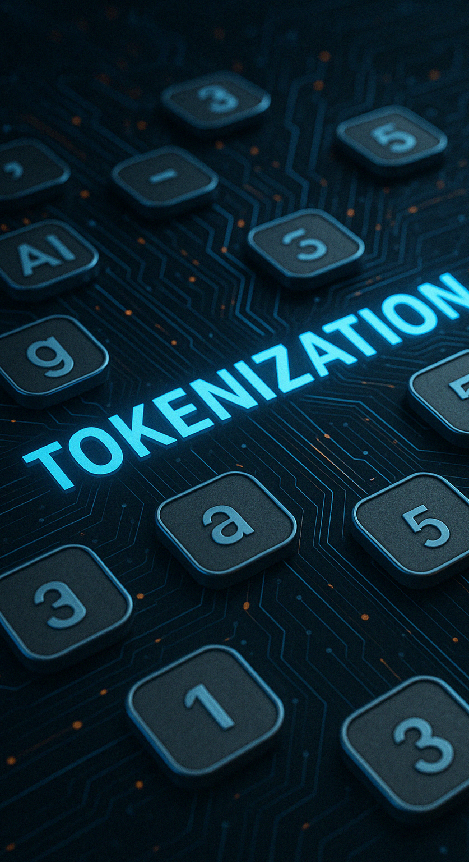
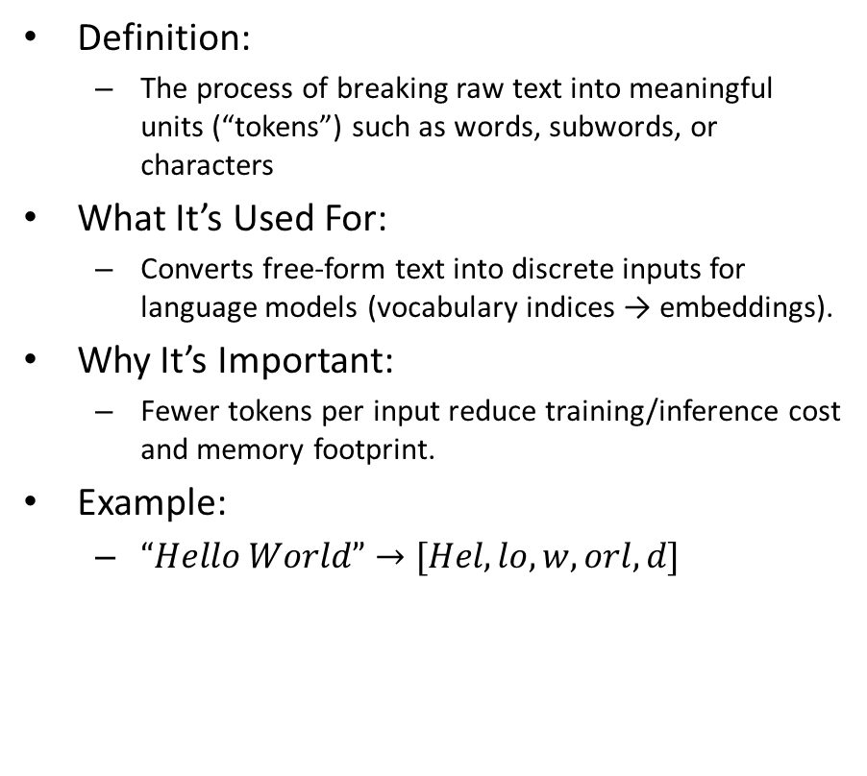
Tokenization
Definition:
The process of breaking raw text into meaningful units (“tokens”) such as words, subwords, or characters
What It’s Used For:
Converts free‐form text into discrete inputs for language models (vocabulary indices → embeddings).
Why It’s Important:
Fewer tokens per input reduce training/inference cost and memory footprint.
Example:
$“Hello World”→[Hel, lo, w,orl,d]$

Slide 4
Tokenization Approaches
Approach | Pros | Cons
Whitespace Tokenization | Simplicity: splits on spaces only, easy to implement | High OOV rate: any unseen word becomes [UNK]
 | Fast tokenization speed with minimal preprocessing | No handling of morphology (e.g., “eat”, “eats”, “eating” treated separately)
 |  | Huge vocabulary size for large corpora
Character-Level Tokenization | Zero OOV: all text broken into known characters | No explicit morphological units (meaning split across characters)
 | Robust to rare scripts and punctuation | Very long token sequences → higher compute cost
Subword-Level Tokenization | Balances vocab size and sequence length | Sensitive to typos
 | Captures common morphemes (e.g., “inter”, “nation”, “al”) | Vocabulary still moderately large

Slide 5
Tokenization Approaches
Approach | Example
Whitespace Tokenization | “hello world” → [“hello”, “world”]
Character-Level Tokenization | “hello world” → [“h”, “e”, “l”, “l”, “o”, “ “ , “w” , “o”, “r”, “l”, “d”]
Subword-Level Tokenization | “congratulation” → [“con”, “gratu”, “la”, “tion”]

Slide 6
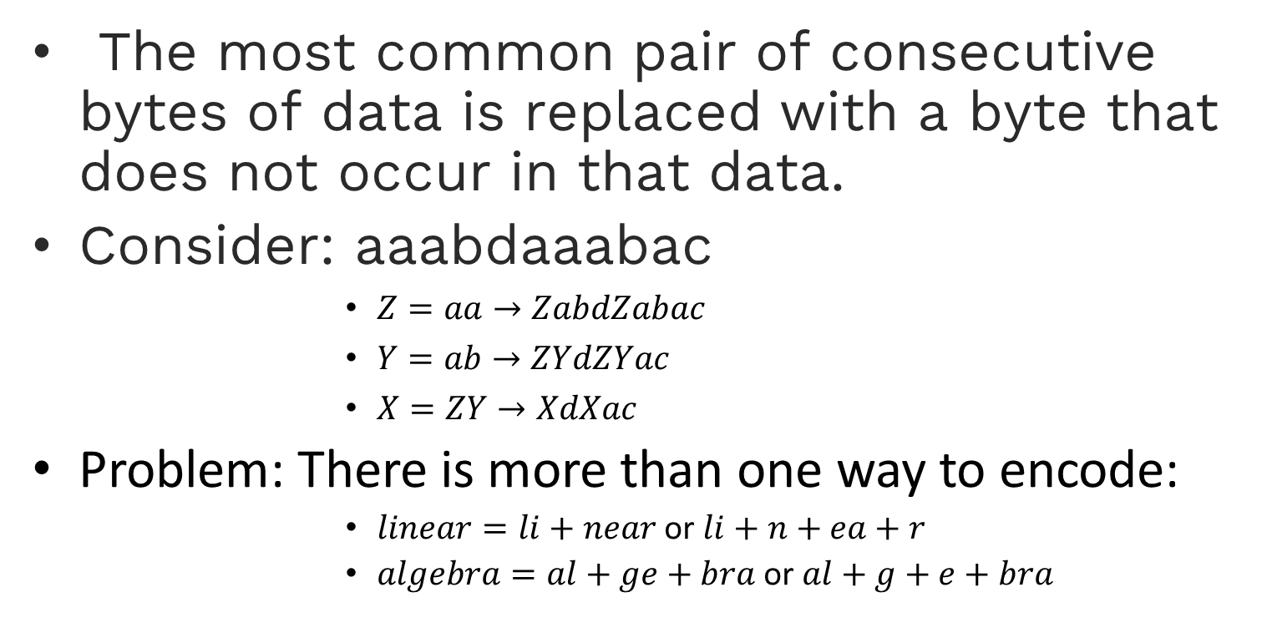
Byte-Pair Encoding (GPT)
The most common pair of consecutive bytes of data is replaced with a byte that does not occur in that data.
Consider: aaabdaaabac
$Z=aa→ZabdZabac$
$Y=ab→ZYdZYac$
$X=ZY→XdXac$
Problem: There is more than one way to encode:
$linear=li+near$ or $li+n+ea+r$
$algebra=al+ge+bra$ or $al+g+e+bra$
See Notebook
Notes:
Create a graph of the vacb size to the log2 of vocab size and number of tokens that represent the dataset
F(text, vocab) = #number_tokens_of_text

Slide 7
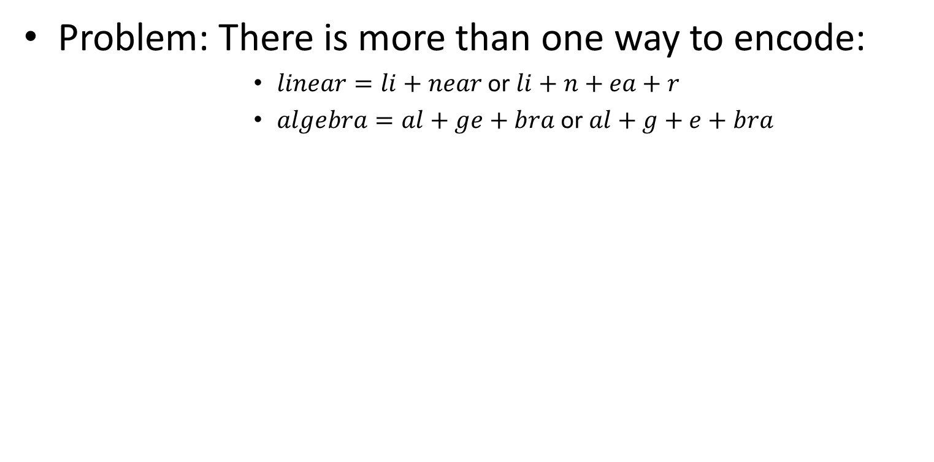
Byte-Pair Encoding (GPT)
Problem: There is more than one way to encode:
$linear=li+near$ or $li+n+ea+r$
$algebra=al+ge+bra$ or $al+g+e+bra$

Slide 8
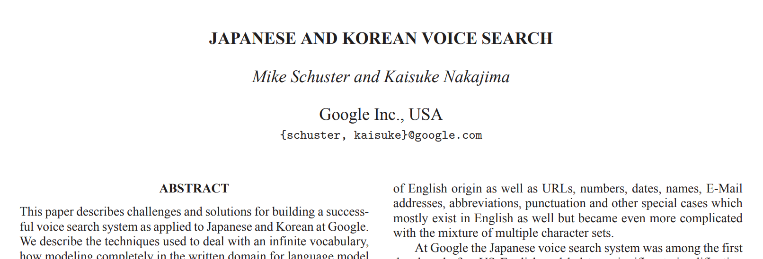
WordPiece (BERT)
A tokenization method called ‘WordPiece’ was introduced in a paper in 2012.
Similar to BPE + Max likelihood.

Slide 9
WordPiece (BERT)
Initiate a word unit inventory with basic Unicode characters.
Build a language model on training data.
Generate a new word unit by combining two units out of the current word inventory.
Choose the word unit that increases the likelihood of training data and add it to the inventory.
Repeat till a predefined limit of word units is reached.
See Notebook

Slide 10
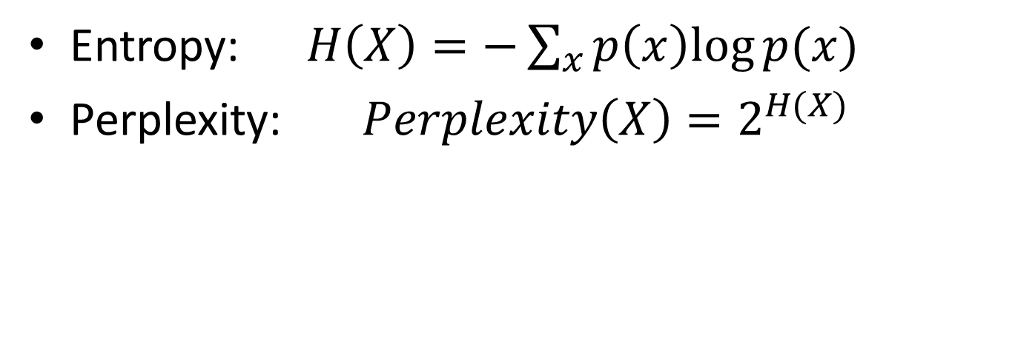
Perplexity
Entropy: $H\left(X\right)=−\sum_{x}{p\left(x\right)log⁡p(x)}$
Perplexity: $Perplexity\left(X\right)=2^{H(X)}$
Perplexity quantifies how surprised the model is by the actual text.
Low perplexity → The model assigns high probability to the correct tokens → Good performance.
High perplexity → The model is "confused" or uncertain → Poor performance.
Notes:
Explain perplexity - Show equations
The efficiency of the representation of the language
Tradeoff – between vocab size and perplexity, and complexity
Does it good to add a big sentence as a token? (lets say 1000 words)

Slide 11
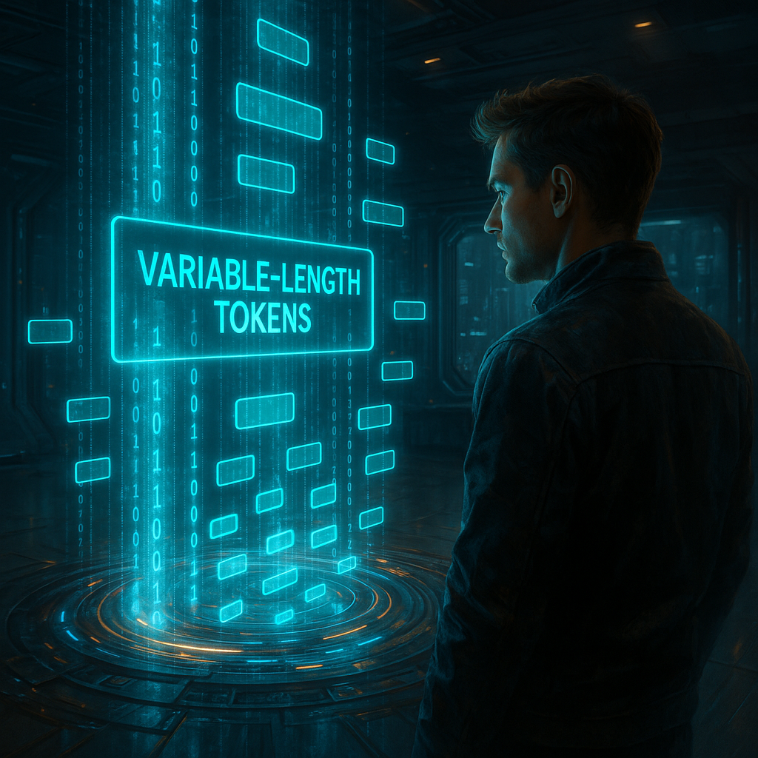
What Makes a Good Tokenizer?
Compression efficiency
Minimize the number of tokens per byte.
Fewer tokens mean fewer embeddings.
Drives training/inference FLOPs and cost.
Perplexity
better tokenization -> lower perplexity
Robustness
Handles unknown/out-of-vocabulary words
Handles multiple languages
Notes:
Explain perplexity - Show equations
The efficiency of the representation of the language
Tradeoff – between vocab size and perplexity, and complexity
Does it good to add a big sentence as a token? (lets say 1000 words)

Slide 12
What Makes a Good Tokenizer?
Vocabulary Size:
Too small vocabulary (for example character based tokenizer) leads to multiple tokens per word which may increase the perplexity (due to more predictions).
Too big vocabulary may lead to poor guessing as well as there are too many tokens to choose from.
Tokens composition:
Tokens should make sense in the context of the task. For example, splitting “eating” to “eat” + “ing” is more natural then choosing “ea” + “ting”. In this way, the tokenizer allows the model to learn about “ing” as a frequent suffix.
Efficiency vs Perplexity:
Very large tokens (like entire phrases) might minimize perplexity but may blow up the vocabulary.
Very small tokens makes the model very efficient but gives higher perplexity.
Overall:
A good tokenizer finds the sweet spot between minimizing tokens per byte without exploding the vocabulary size, and does so consistently across all languages, domains, and noisy inputs that your LLM will meet.
Notes:
Explain perplexity - Show equations
The efficiency of the representation of the language
Tradeoff – between vocab size and perplexity, and complexity
Does it good to add a big sentence as a token? (lets say 1000 words)

Slide 13
What Makes a Good Tokenizer?
Vocabulary Size:
Too small vocabulary (for example character based tokenizer) leads to multiple tokens per word which may increase the perplexity (due to more predictions).
Too big vocabulary may lead to poor guessing as well as there are too many tokens to choose from.
Tokens composition:
Tokens should make sense in the context of the task. For example, splitting “eating” to “eat” + “ing” is more natural then choosing “ea” + “ting”. In this way, the tokenizer allows the model to learn about “ing” as a frequent suffix.
Efficiency vs Perplexity:
Very large tokens (like entire phrases) might minimize perplexity but may blow up the vocabulary.
Very small tokens makes the model very efficient but gives higher perplexity.
Overall:
A good tokenizer finds the sweet spot between minimizing tokens per byte without exploding the vocabulary size, and does so consistently across all languages, domains, and noisy inputs that your LLM will meet.
See Notebook
Notes:
Explain perplexity - Show equations
The efficiency of the representation of the language
Tradeoff – between vocab size and perplexity, and complexity
Does it good to add a big sentence as a token? (lets say 1000 words)

Slide 14

LZW Compression Algorithm
Lossless data compression method
- Builds dictionary of seen phrases
- Replaces phrases with dictionary indices
- Reconstructs the original using same dictionary
Notes:
Represent text by binary strings

Slide 15
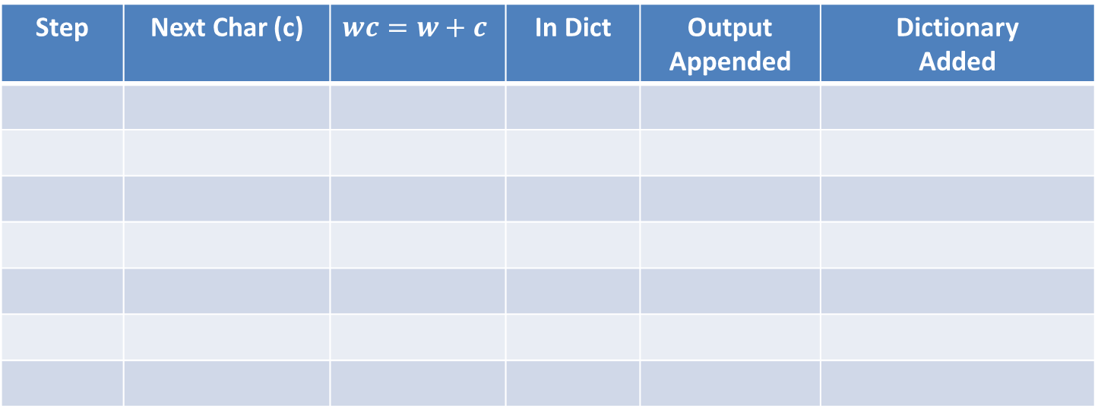
Live Demonstration: LZW Compression
Text: ABABABA
W:
Step | Next Char (c) | $$wc=w+c$$ | In Dict | Output Appended | Dictionary Added
Dict:
output:

Slide 16
Live Demonstration: LZW Compression
Text: ABABABA
W: “”
Step | Next Char (c) | $$wc=w+c$$ | In Dict | Output Appended | Dictionary Added
Dict: {A: 0, B: 1}
output: []

Slide 17
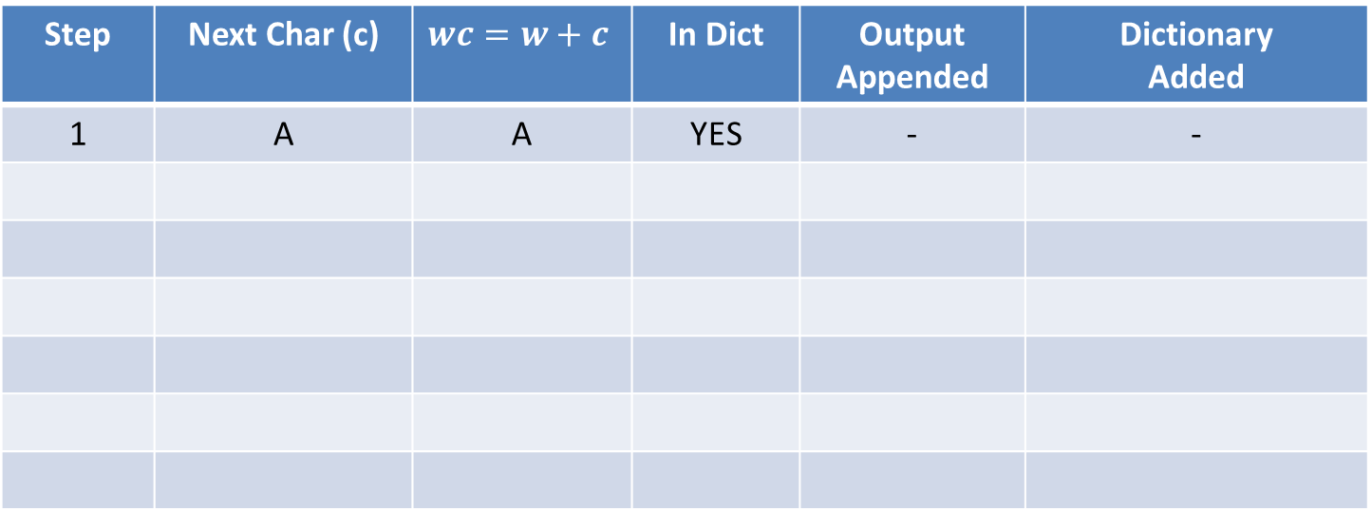
Live Demonstration: LZW Compression
Text: ABABABA
W: A
Step | Next Char (c) | $$wc=w+c$$ | In Dict | Output Appended | Dictionary Added
1 | A | A | YES | - | -
Dict: {A: 0, B: 1}
output: []

Slide 18
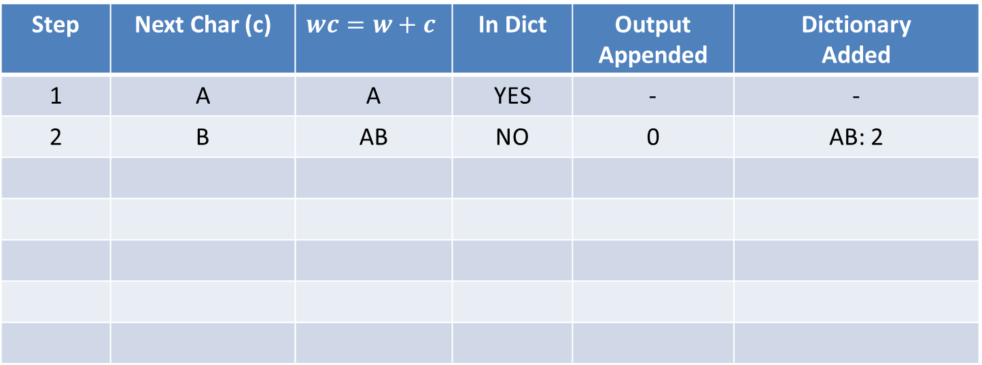
Live Demonstration: LZW Compression
Text: ABABABA
W: B
Step | Next Char (c) | $$wc=w+c$$ | In Dict | Output Appended | Dictionary Added
1 | A | A | YES | - | -
2 | B | AB | NO | 0 | AB: 2
Dict: {A: 0, B: 1, AB: 2}
output: [0]

Slide 19
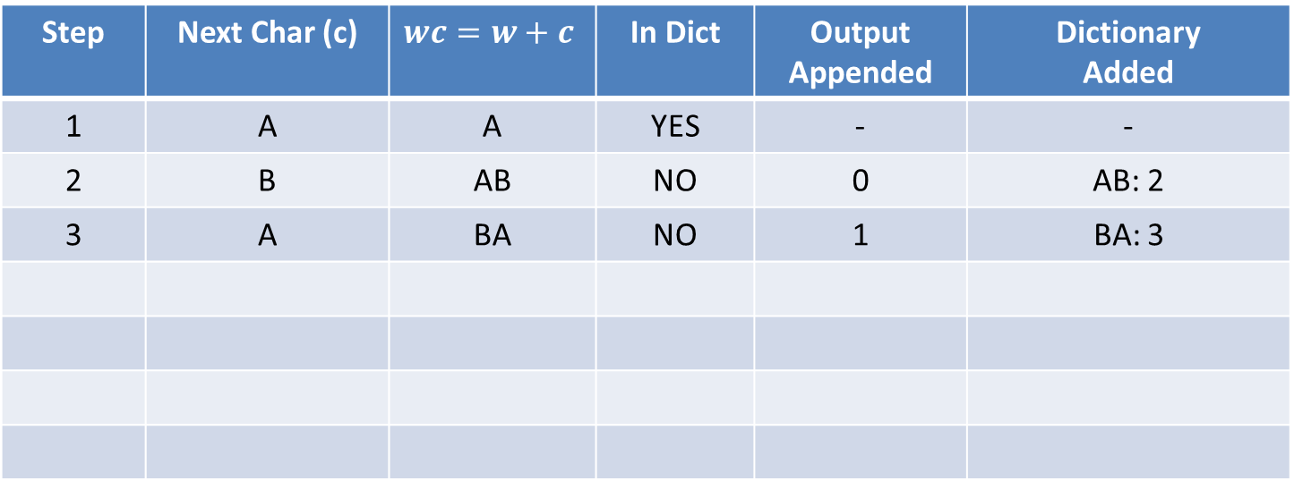
Live Demonstration: LZW Compression
Text: ABABABA
W: A
Step | Next Char (c) | $$wc=w+c$$ | In Dict | Output Appended | Dictionary Added
1 | A | A | YES | - | -
2 | B | AB | NO | 0 | AB: 2
3 | A | BA | NO | 1 | BA: 3
Dict: {A: 0, B: 1, AB: 2, BA: 3}
output: [0, 1]

Slide 20
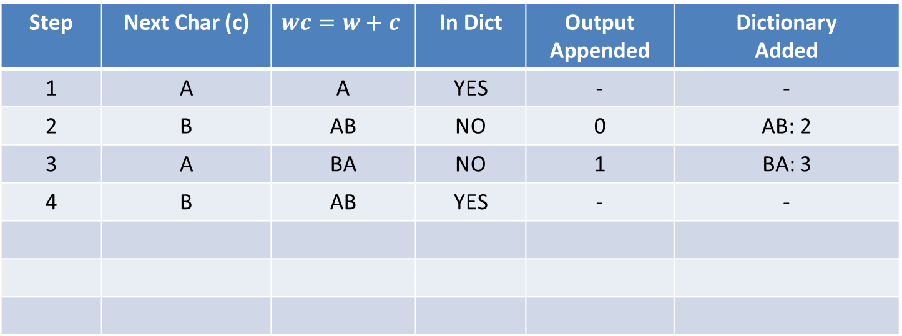
Live Demonstration: LZW Compression
Text: ABABABA
W: AB
Step | Next Char (c) | $$wc=w+c$$ | In Dict | Output Appended | Dictionary Added
1 | A | A | YES | - | -
2 | B | AB | NO | 0 | AB: 2
3 | A | BA | NO | 1 | BA: 3
4 | B | AB | YES | - | -
Dict: {A: 0, B: 1, AB: 2, BA: 3}
output: [0, 1]

Slide 21
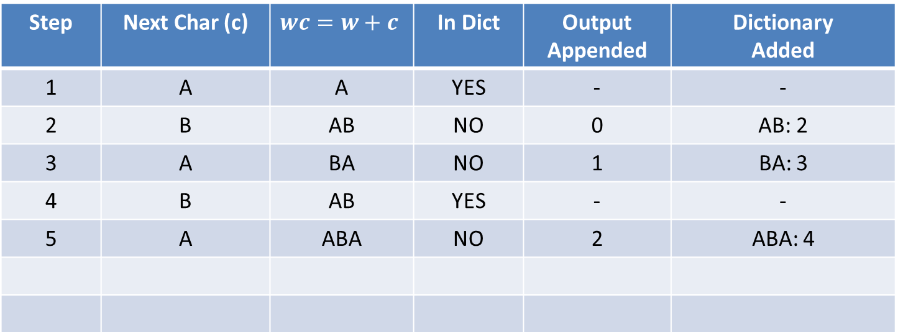
Live Demonstration: LZW Compression
Text: ABABABA
W: A
Step | Next Char (c) | $$wc=w+c$$ | In Dict | Output Appended | Dictionary Added
1 | A | A | YES | - | -
2 | B | AB | NO | 0 | AB: 2
3 | A | BA | NO | 1 | BA: 3
4 | B | AB | YES | - | -
5 | A | ABA | NO | 2 | ABA: 4
Dict: {A: 0, B: 1, AB: 2, BA: 3, ABA: 4}
output: [0, 1, 2]

Slide 22
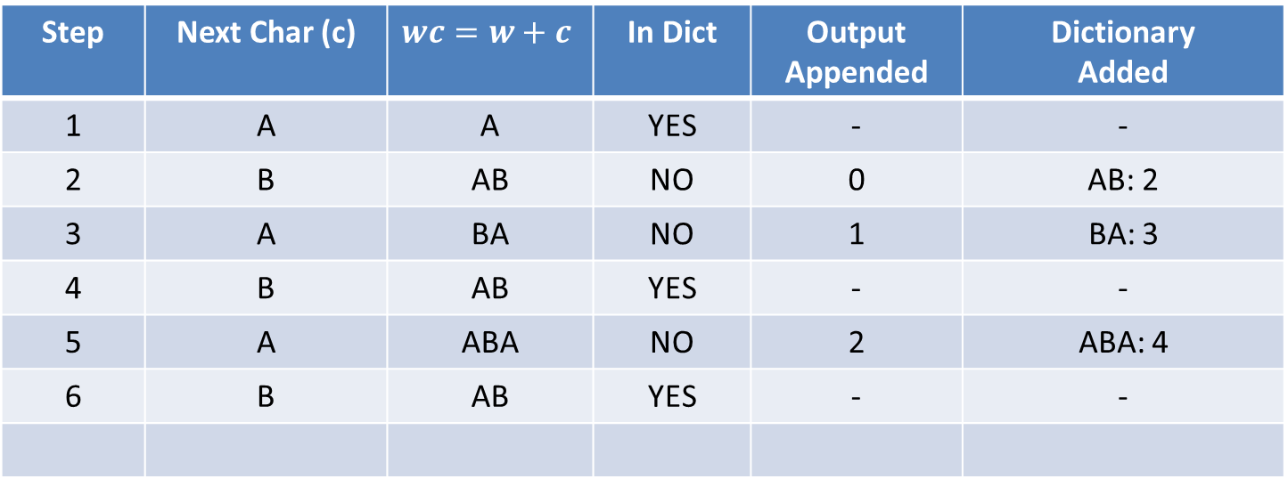
Live Demonstration: LZW Compression
Text: ABABABA
W: AB
Step | Next Char (c) | $$wc=w+c$$ | In Dict | Output Appended | Dictionary Added
1 | A | A | YES | - | -
2 | B | AB | NO | 0 | AB: 2
3 | A | BA | NO | 1 | BA: 3
4 | B | AB | YES | - | -
5 | A | ABA | NO | 2 | ABA: 4
6 | B | AB | YES | - | -
Dict: {A: 0, B: 1, AB: 2, BA: 3, ABA: 4}
output: [0, 1, 2]

Slide 23
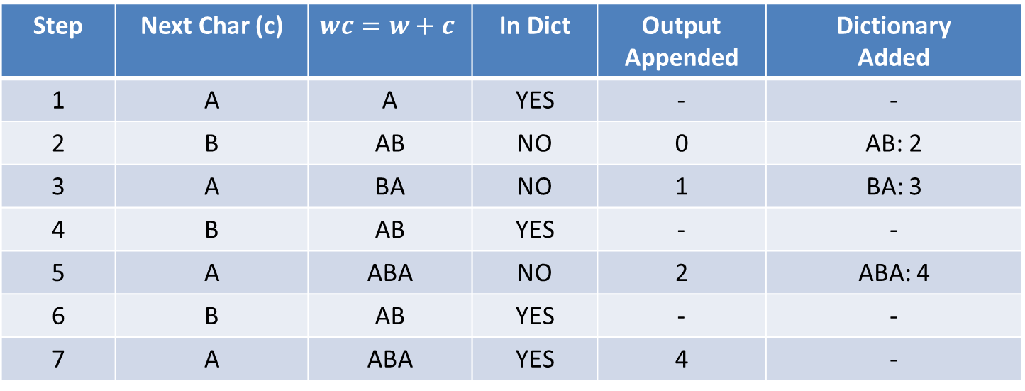
Live Demonstration: LZW Compression
Text: ABABABA
W: ABA
Step | Next Char (c) | $$wc=w+c$$ | In Dict | Output Appended | Dictionary Added
1 | A | A | YES | - | -
2 | B | AB | NO | 0 | AB: 2
3 | A | BA | NO | 1 | BA: 3
4 | B | AB | YES | - | -
5 | A | ABA | NO | 2 | ABA: 4
6 | B | AB | YES | - | -
7 | A | ABA | YES | 4 | -
Dict: {A: 0, B: 1, AB: 2, BA: 3, ABA: 4}
output: [0, 1, 2, 4]

Slide 24
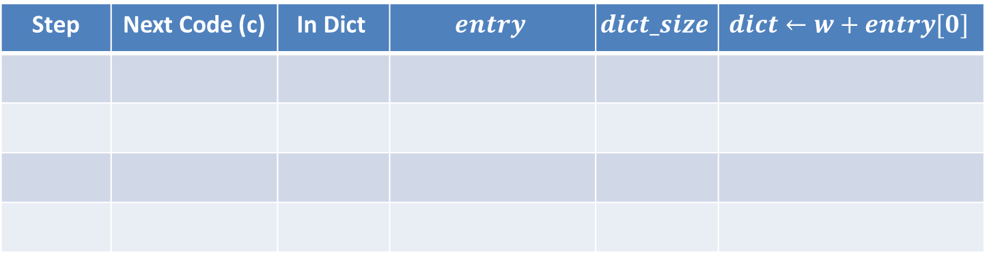
Live Demonstration: LZW Decompression
Input:[0, 1, 2, 4]
W new:
Step | Next Code (c) | $$\text{In} \text{Dict}$$ | $$entry$$ | $$dict_size$$ | $$dict←w+entry[0]$$
Dict: {0: A, 1: B}
output: “”

Slide 25
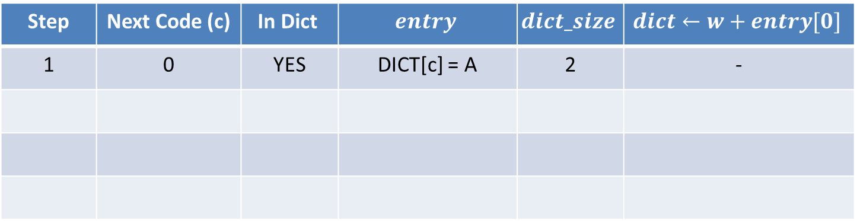
Live Demonstration: LZW Decompression
Input:[0, 1, 2, 4]
W new: A
Step | Next Code (c) | $$\text{In} \text{Dict}$$ | $$entry$$ | $$dict_size$$ | $$dict←w+entry[0]$$
1 | 0 | YES | DICT[c] = A | 2 | -
Dict: {0: A, 1: B}
output: “A”

Slide 26
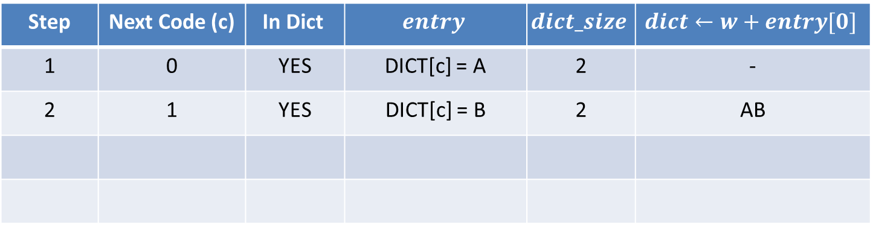
Live Demonstration: LZW Decompression
Input:[0, 1, 2, 4]
W new: B
Step | Next Code (c) | $$\text{In} \text{Dict}$$ | $$entry$$ | $$dict_size$$ | $$dict←w+entry[0]$$
1 | 0 | YES | DICT[c] = A | 2 | -
2 | 1 | YES | DICT[c] = B | 2 | AB
Dict: {0: A, 1: B, 2: AB}
output: “AB”

Slide 27
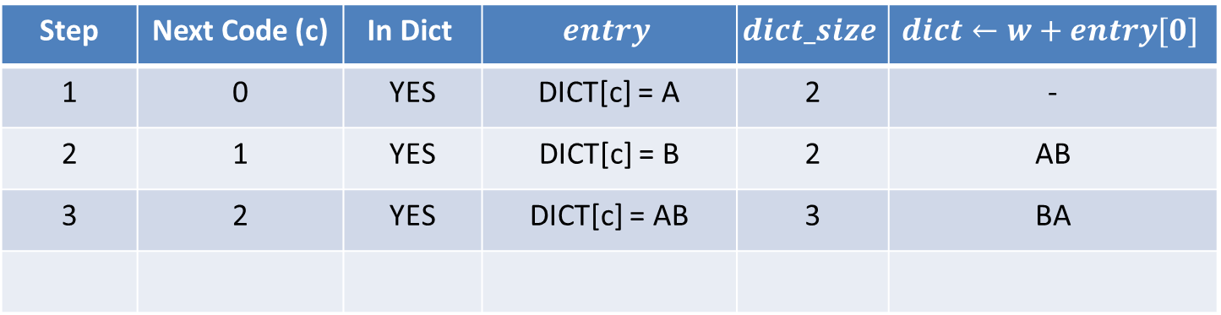
Live Demonstration: LZW Decompression
Input:[0, 1, 2, 4]
W new: AB
Step | Next Code (c) | $$\text{In} \text{Dict}$$ | $$entry$$ | $$dict_size$$ | $$dict←w+entry[0]$$
1 | 0 | YES | DICT[c] = A | 2 | -
2 | 1 | YES | DICT[c] = B | 2 | AB
3 | 2 | YES | DICT[c] = AB | 3 | BA
Dict: {0: A, 1: B, 2: AB, 3: BA}
output: “ABAB”

Slide 28
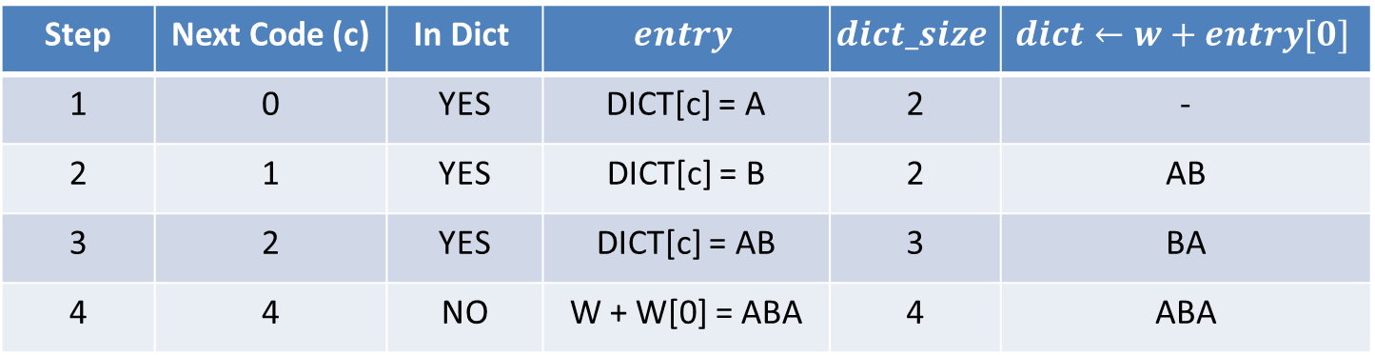
Live Demonstration: LZW Decompression
Input:[0, 1, 2, 4]
W new: ABA
Step | Next Code (c) | $$\text{In} \text{Dict}$$ | $$entry$$ | $$dict_size$$ | $$dict←w+entry[0]$$
1 | 0 | YES | DICT[c] = A | 2 | -
2 | 1 | YES | DICT[c] = B | 2 | AB
3 | 2 | YES | DICT[c] = AB | 3 | BA
4 | 4 | NO | W + W[0] = ABA | 4 | ABA
Dict: {0: A, 1: B, 2: AB, 3: BA, 4: ABA}
output: “ABABABA”
See Notebook

Slide 29
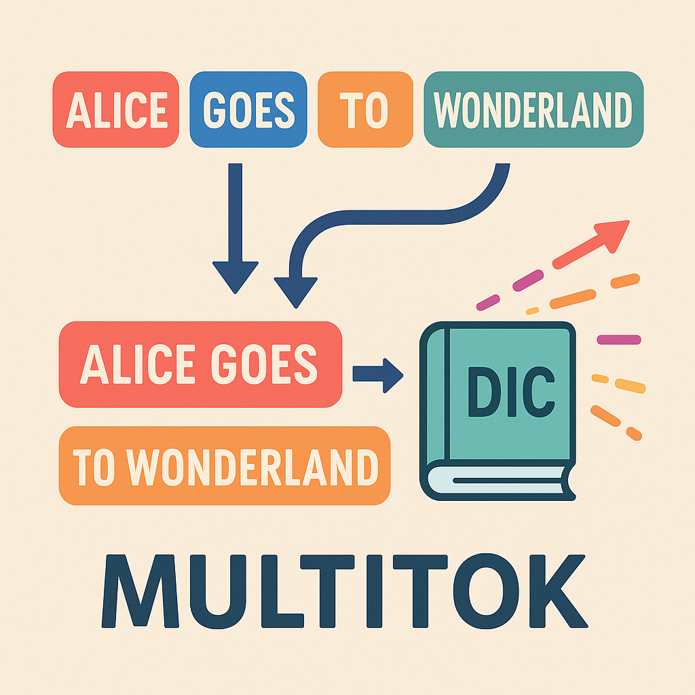
Introducing MultiTok
Motivation:
Training state-of-the-art LLMs demands massive datasets, expensive hardware, and long runtimes.
Data size for LLMs has grown 3× per year since 2010, leading to exponential training times.
Key Idea:
Leverage Lempel – Ziv - Welch (LZW) style variable-length tokenization to compress repetitive multi-word phrases into single tokens.

Slide 30
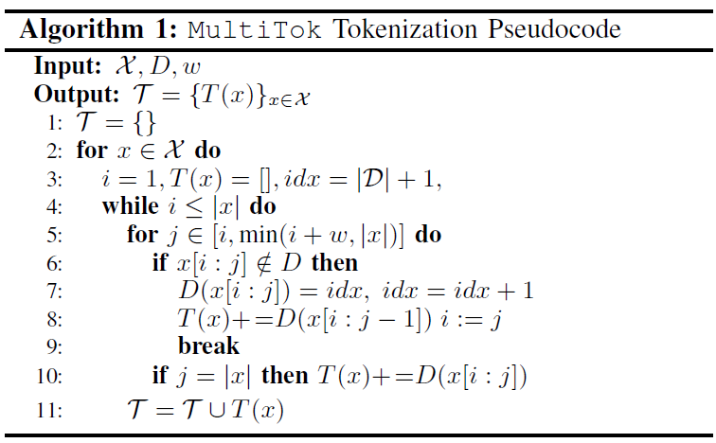
MultiTok Tokenization Algorithm

Slide 31
Experimental Setup
Datasets:
IMDB (binary sentiment)
SST-2 (binary sentiment)
AG-News (four-class news categorization)
Model Architecture:
Embedding dim = 100, 2 attention heads
Sinusoidal positional encoding added to embeddings
1 MultiheadAttention layer
200 Linear Layer + ReLu
100 Linear Layer + ReLu
Classification head + Sigmoid
Evaluation:
Averaged over 20 trials: training loss, train/test accuracy per epoch
Compression ratio & ROC-AUC recorded and graphed

Slide 32
Results
Experiment conduct on MultiTok, MultiTok + BERT, Pruned MultiTok
Up to 33% fewer tokens on average across IMDB, SST-2, and AG-News
2.5× faster convergence (epochs to 90% of peak accuracy) compared to the standard BPE tokenizer

Slide 33
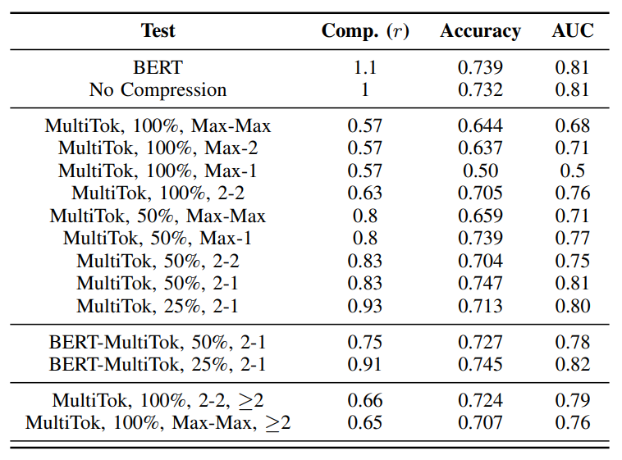
Results

Slide 34
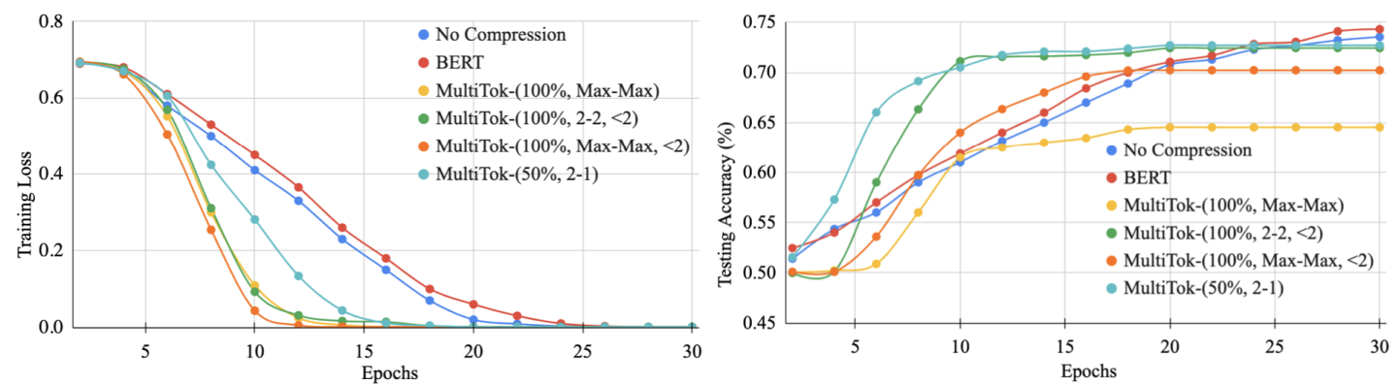
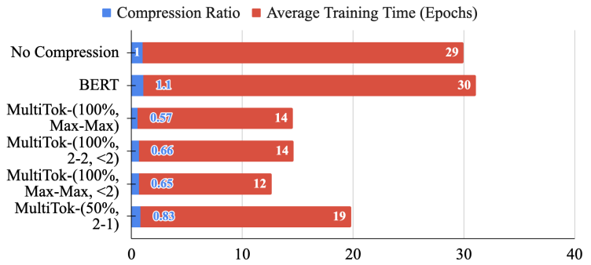
Results

Slide 35
Live Demo
On Colab

Slide 36
Questions?
Thanks for listening!

